Slide 1

Unveiling the Cybersecurity Frontier: Tales of a Threat Hunter’s Journey
Sneha Banerjee Cyber Threat Hunt Analyst 2, Microsoft linkedin.com/in/sneha-banerjee-b10a2b1aa/

Slide 2

About me
Sneha Banerjee Cyber Threat Hunt Analyst at Microsoft’s Cloud and AI Global Threat Hunting Team - Specializes in Threat Hunting, Incident Response and Cyber Investigations - Azure Red Teaming Operations - Visualization of Threats for scaling future hunt operations - Detection Engineering Certifications - Certified Ethical Hacker (CEHv10) - Certified Azure Red Team Professional - AWS Certified Solutions Architect Education - B. Tech in Computer Science and Engineering - Professional Training in Applied Data Science and Machine Learning – IIT Kanpur

Slide 3
Agenda
What is Threat Hunting?
Why Threat Hunting and what are its benefits?
Threat Hunting Maturity Model
Threat Hunting – The Slide Scale of Cyber Security
Threat Hunting – Critical Success Factors
Threat Hunting – Overall Process
Threat Hunting : A Word on Automation
Incident Response
Incident Response Team Disciplines
Incident Response Process

Slide 4
So, what is Threat Hunting all about?
Threat hunting complements normal security monitoring by manually identifying potentially malicious behavior.
It helps to identify if anything is being missed and to improve monitoring capabilities.
Threat hunting is valuable but requires a certain level of maturity and reinforces how monitoring is being done.

Slide 5
Can we detect advanced adversaries in Real Time?
1. Log Centralization
2. IDS
3. 24/7 SOC
4. SIEM Technology
5. Next Gen Firewall
6. Alerting
However, we do not have alerts or signatures for all kinds of threats. This is not going to cover everything

Slide 6
Real Time Detection Issues: Security Alert Fatigue
74 % Reported that Security Events or Alerts are simply ignored because their teams can’t keep up with the suffocating volume

Slide 7
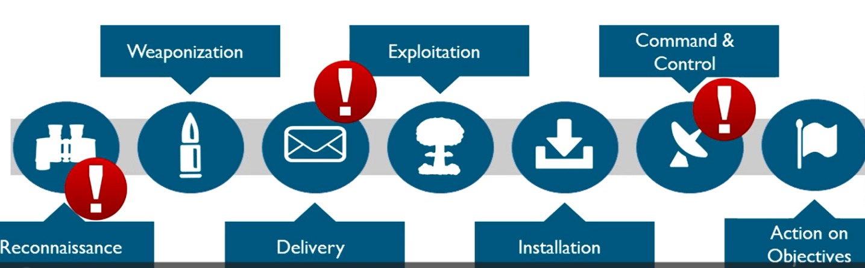
Real Time Detection Issues: Sophisticated attacks have different steps

Slide 8
Can you really detect sophisticated attacks in real-time?
99 days * The global median time between compromise and detection is 99 days * (Source: FireEye M-Trends 2017)

Slide 9
Real-Time Detection Issues: Summary
Advanced adversaries use unknown techniques that can't be detected by predefined alerts or signatures.
Real-time detection can result in false positives and noise due to lack of in-depth analytics.
Outsourcing real-time detection to external SOCs can result in increased noise due to lack of context on your environment.

Slide 10
Threat Hunting vs. Real Time Detection
Real Time Detection | Threat Hunting
Relies on known bads (e.g., Signatures, Rules) | “Hunt” environment for unknown bads
Generates alerts that are to be further investigated by analyst | Generates confirmed incidents, which trigger incident response
Is highly automated | Can partially leverage automation, but majority is manual effort
Can leverage Indicators of Compromise | Can generate Indicators of Compromise

Slide 11
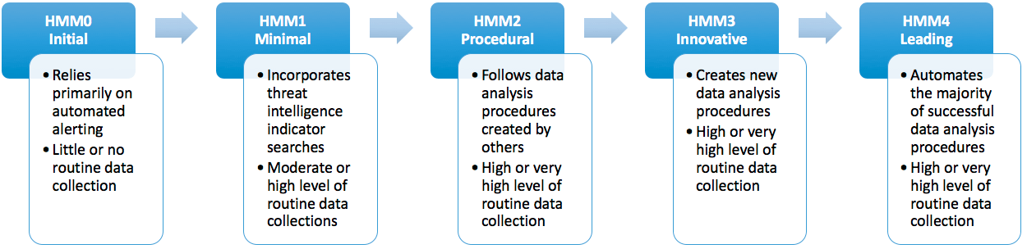
Threat Hunting Maturity Model

Slide 12
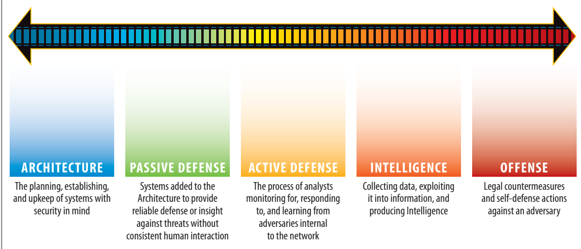
Threat Hunting – The Slidescale of Cybersecurity

Slide 13
Threat Hunting – Critical Success Factors
Experienced analyst who understands attacks and your environment
Large collection of logs from different parts of your environment
Centralized data repository for collecting logs
Visualization tool for deeper analysis and investigation

Slide 14
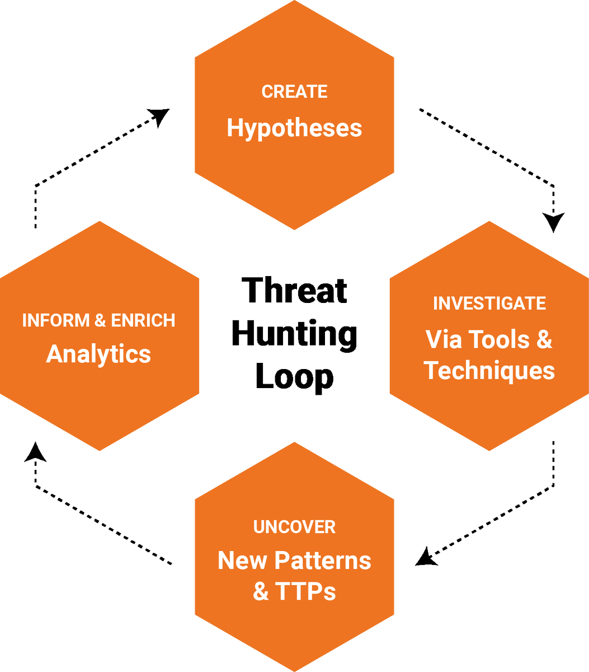
Threat Hunting – Overall Process

Slide 15
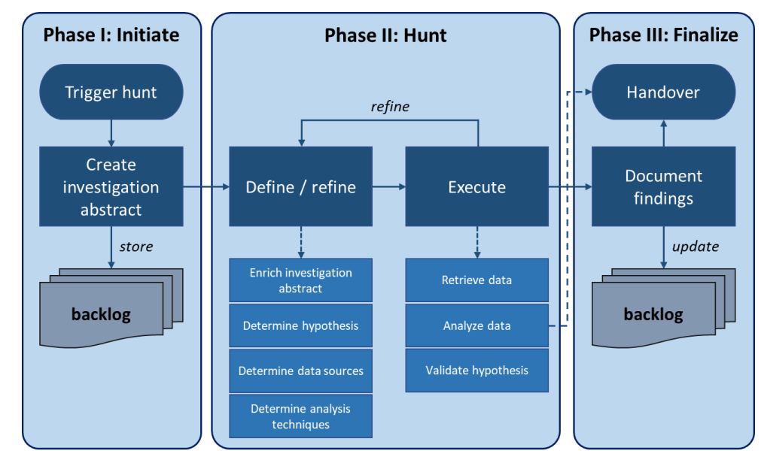
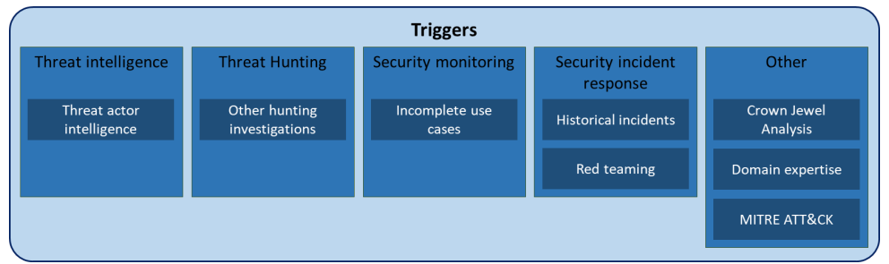
TaHiTi Model

Slide 16
Threat Hunting – Definition of Hypothesis is Key!
Intelligence Driven hypothesis
Situational Awareness hypothesis
Domain expertise hypothesis

Slide 17
Threat Hunting: A Word on Automation
"Fully automated" threat hunting solutions do not exist
Automation can be useful, but it is not enough
Threat hunting benefits from automation due to large volumes of data
Automated log collection from endpoint systems is helpful
Data analysis techniques can present data in a meaningful way to hunters
Human effort is crucial in defining/creating data analysis techniques and reviewing results

Slide 18
Threat Hunting - Summary
Threat hunting can provide high ROI depending on the maturity of the organization.
The process of threat hunting can't be fully automated, and the experience of the hunt is important.
Successful threat hunting requires expert resources, a central repository for logs, and data parsing or visualization tools.

Slide 19
Incident Response
Incident response (IR) is the steps used to prepare for, detect, contain, and recover from a data breach.

Slide 20
Incident Response Team Disciplines
Lead Investigators
Incident Managers
Infra
Forensics
Reverse Engineers
Developers

Slide 21
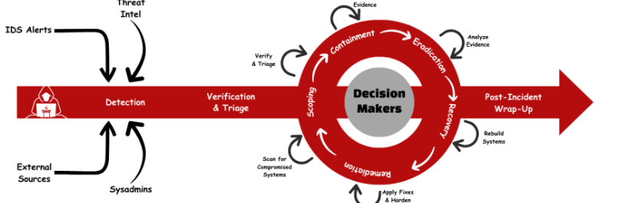
Dynamic Approach to Incident Response

Slide 22
Key Takeaways
Proactive threat hunting is essential for staying ahead of evolving cyber threats and improving overall security posture.
Threat hunting requires skilled analysts, effective processes, and the right tools to be successful.
Incident response is a structured approach to managing and responding to security incidents that helps organizations minimize the impact of a security breach and restore normal operations as quickly as possible.
Incident response requires collaboration between different teams and departments, and a well-defined plan with clear communication channels.
Automation can help streamline the threat hunting process and enable faster response times, but it should be used in conjunction with human analysis and decision-making.
Finally, it's important for organizations to continuously assess and improve their threat hunting and incident response capabilities to stay ahead of the ever-evolving threat landscape.

